Slide 1
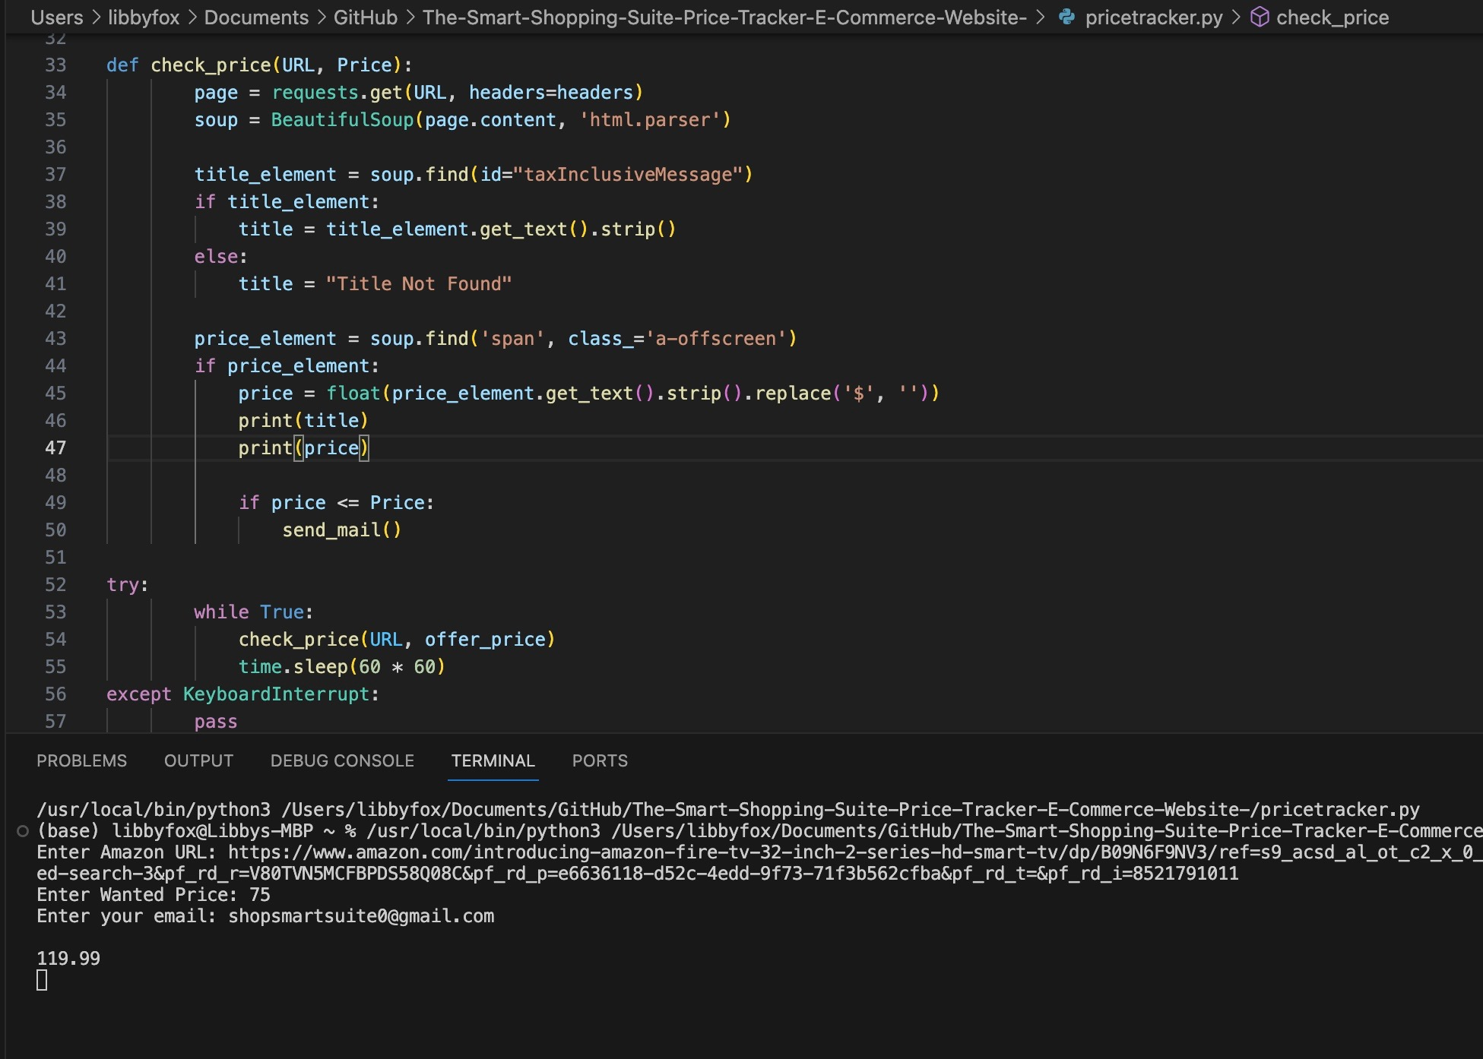
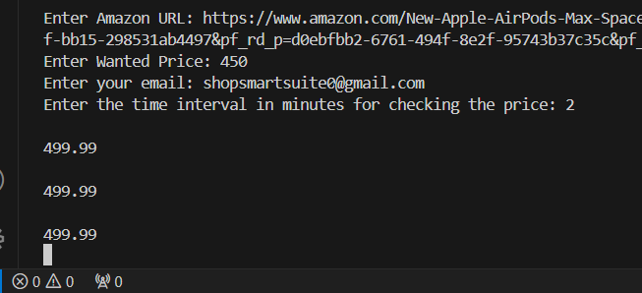
The Smart Shopping Suite-Price-Tracker By: Deja Boney and Libby Fox
https://github.com/ksu-is/The-Smart-Shopping-Suite-Price-Tracker-E-Commerce-Website-/blob/main/pricetracker.py
The Smart Shopping Suite would be a comprehensive Python-powered application that amalgamates the functionality of a product and its price.
The price is always tracked based on the interval
Ex: In this case, the price is tracked every 2 minutes!
Where prices are always tracked!

